Slide 1
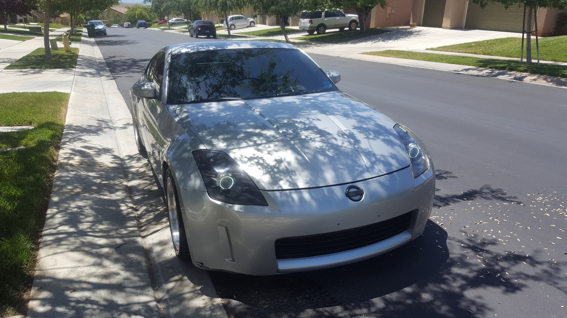
OpenZ
HnB Enterprises
Team Members:
Alyssa Abram
Joshua Bonner
Richard Bowers
Jonathan Edsell
Jacob Gallucci
Ariel Rupp

Slide 2
AGENDA
PURPOSE
PARKING COLLISION DETECTION
ON BOARD DIAGNOSTICS
GPS NAVIGATION
USER INTERFACE
LANE DEPARTURE DETECTION
MUSIC PLAYER
WRAP UP
Q/A

Slide 3
Purpose
In the beginning we sought to challenge ourselves and expand our knowledge within the realms of computer science and engineering. We decided to create a complex project consisting of multiple disciplines not only within the computer science field but that of other engineering fields as well.
Thus we created, from scratch, an infotainment system customized for the Nissan 350z.
With the composition of the team and its many different talents, we divulged our own unique touches on the system to create something that stands out from other projects.
It is our hope that you will be just as impressed as we are with the functionality and all that the system is capable of.

Slide 4
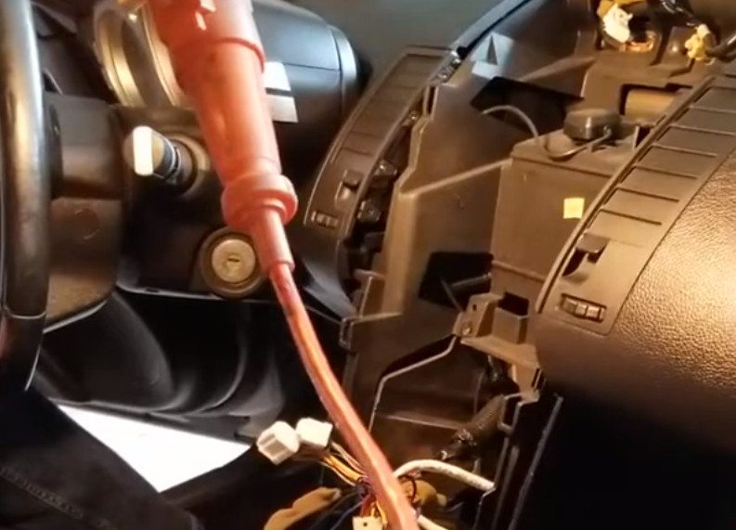
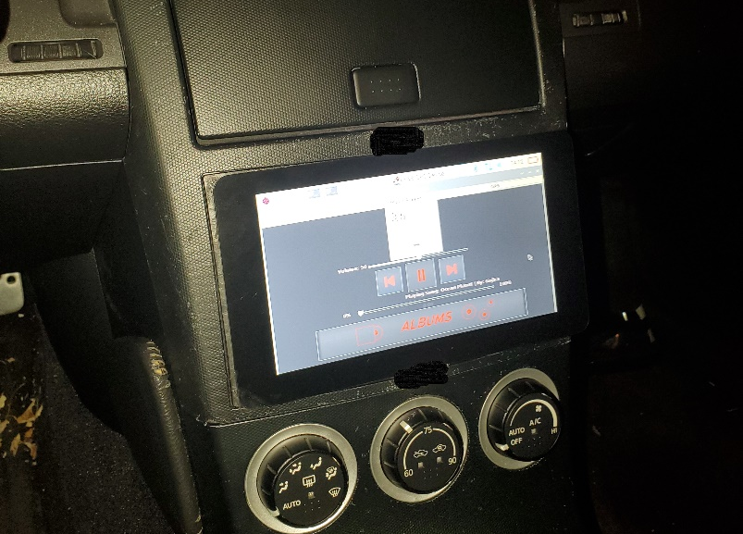
Infotainment system
As mentioned previously, we created an infotainment system that includes many functions which will be discussed in this presentation.
The system includes, a Raspberry Pi4 micro computer attached to a touch screen LCD which is used in place of a headunit inside a Nissan 350z.
With some research, we connected the appropriate wires from the gutted dash of the vehicle. This required the expertise and knowledge of many disciplines such as electrical engineering and some mechanical know how.
The end result is a fully functional computer embedded into a motor vehicle.

Slide 5
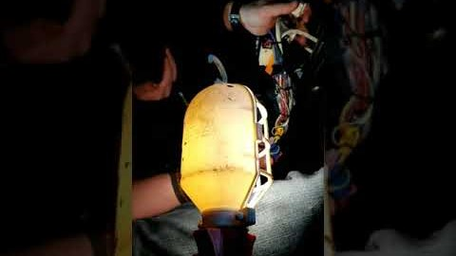
INSTALLING IN THE 350Z
Over the spring break, we got together to install the infotainment system into the Nissan 350z.
As you can see, the car’s old system was removed so that the new one could be installed.
As a group, we discussed the best way to proceed with the installation of the infotainment system.

Slide 6
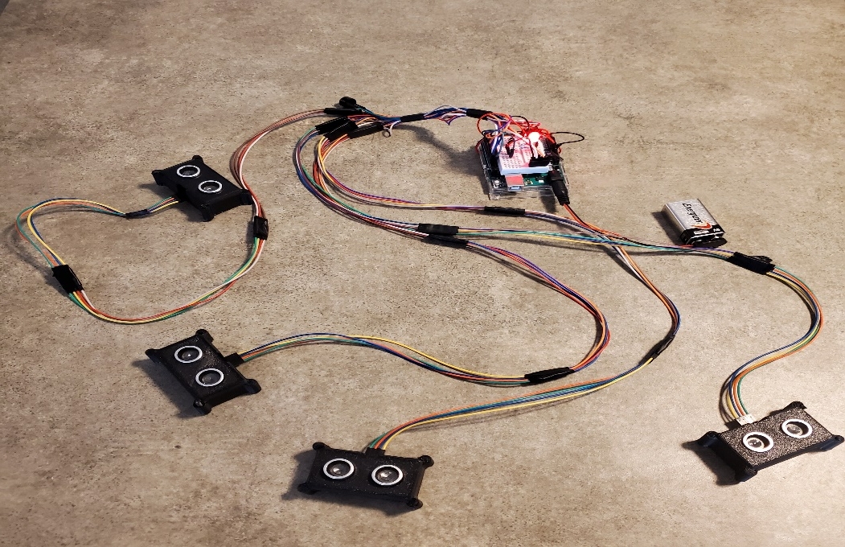
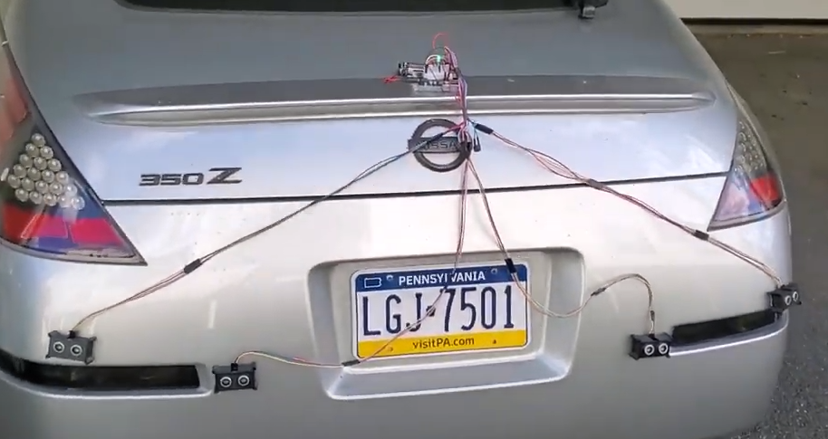
Parking collision detection
Lead Engineer: Joshua Bonner
To create a parking collision detector, we needed to make use of some hardware designed to be used with the Arduino micro controller.
Using 4 SR04 Ultra Sonic Sensors, a passive buzzer, and a few LEDs, we created a system which alerts the user of a potential collision during a parking maneuver.
The sensors will detect objects using ultra sonic waves to determine the distance between the encroaching object and the sensors themselves.
At a predefined distance the sensors will communicate via the Arduino with the passive buzzer and provide distinct beeps alerting the user of the potential collision.
Paired with the passive buzzer are the LEDs which will indicate certain statuses of the PCD system.

Slide 7
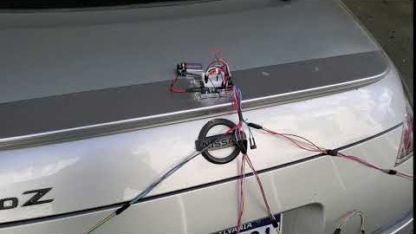
Parking collision detection

Slide 8
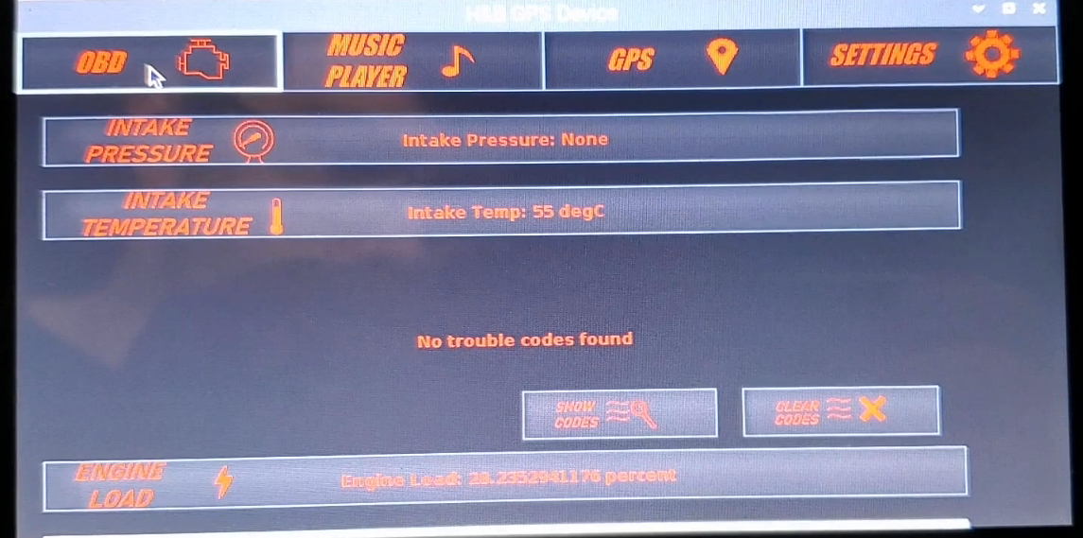
On board diagnostics
Lead Engineer: Richard Bowser
Given that this system is for a motor vehicle, we decided that it would be an important function to provide the user with vehicle data generated by the Engine Control Module.
Using the On Board Diagnostic interface, common in most vehicles, we can pull, display, and reset real time data from the engines CPU, including maintenance codes used by mechanics to diagnose engine issues.
A server on the Raspberry Pi is set up to receive incoming data retrieved by the OBDII and then displayed on the user interface
Additional data pertinent to the use of this vehicle includes engine load, intake temperature, and throttle position.

Slide 9
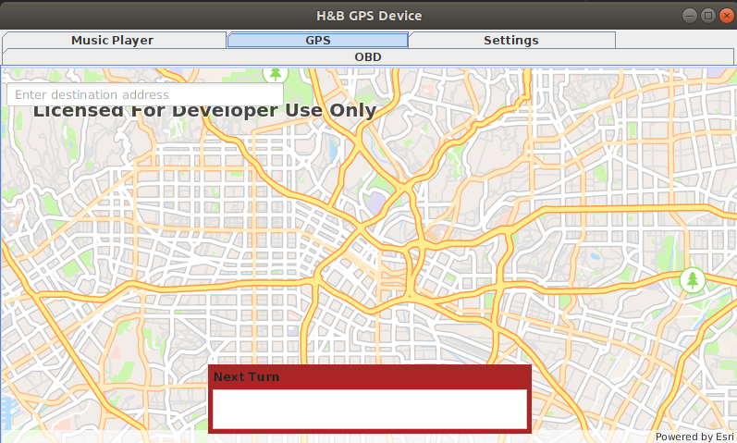
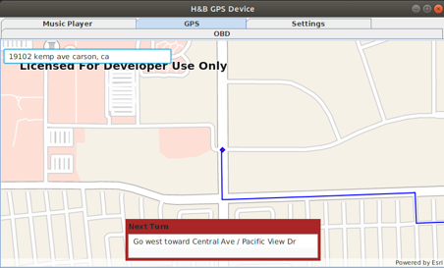
GLOBAL POSITIONING SYSTEM
Lead Engineer: Alyssa Abram
Many infotainment systems also provide GPS navigation, some use systems with built in maps and others use systems that require subscriptions.
With no internet connection, offline maps had to be used.
ArcGIS, a geographic information system by ERSI, provides an SDK that is available for free for Penn State students.
ArcGIS also has a Mobile Map Package that contains all the data needed for offline navigation, and then some.
A map of Pennsylvania was not able to be obtained due to the high cost. Therefore all implementation and testing has occurred on a free for development map of the Greater Los Angeles area.

Slide 10
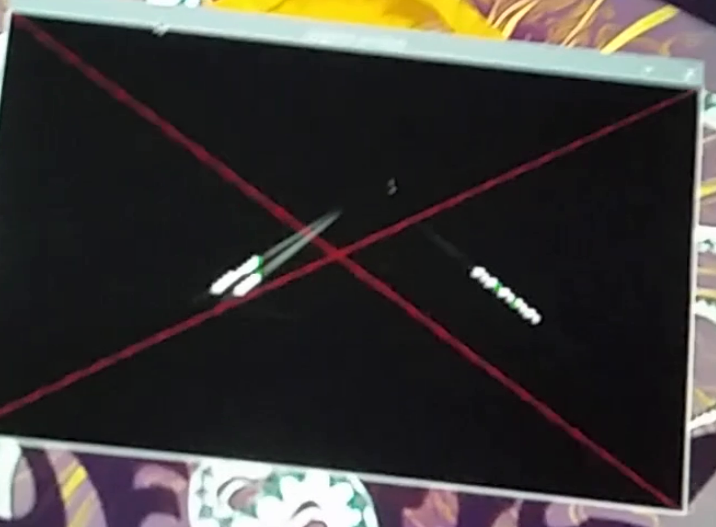
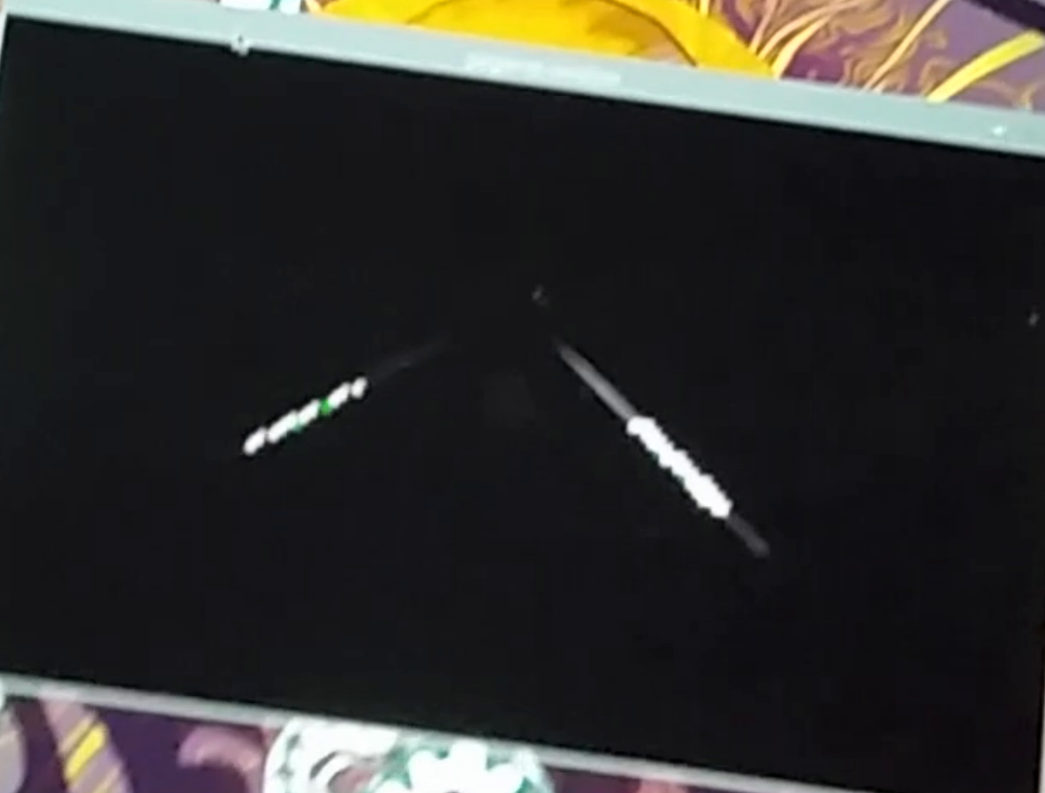
Lane Departure Detection
Lead Engineer: Jacob Gallucci
As the title suggests, we have implemented a lane departure system that will warn the user when they are drifting from their lane when the vehicle is in motion.
The system makes use of a camera designed to work with the Raspberry Pi micro computer and uses machine vision, in its traditional sense, to detect the brightly colored lines on a normal road.
Once the system recognizes these lines within a defined area, if the lines move too far from one side of the predefined area, the system alerts the user with a distinct audible beep until the user corrects their trajectory.

Slide 11
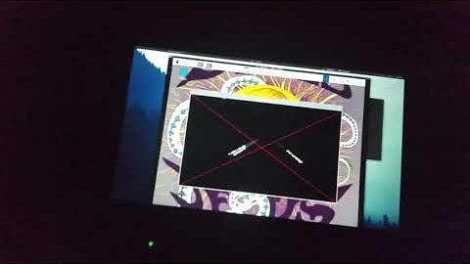
Lane Departure Detection

Slide 12
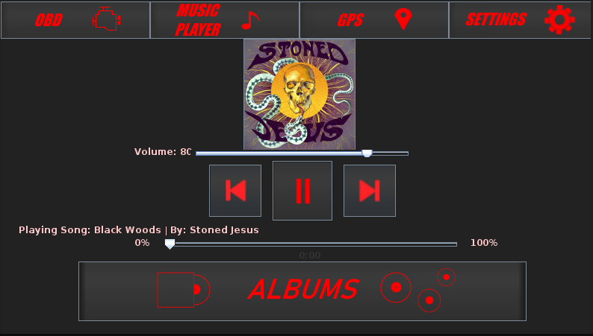
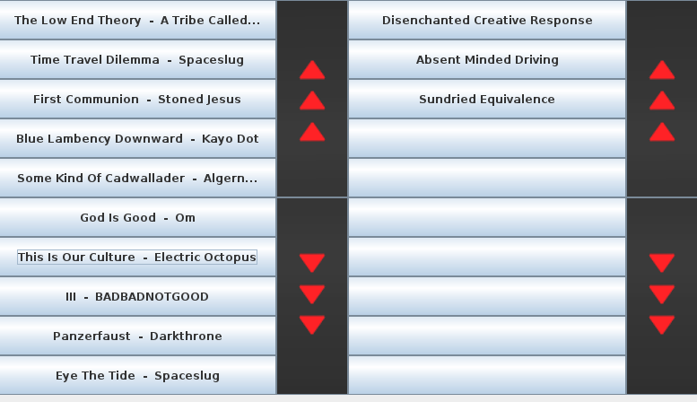
Music Player
Lead Engineer: Jacob Gallucci
A standard expectation of an infotainment system is to provide the user the ability to listen to music of their choice when traveling. Thus, we created our own music player.
Our system includes a completely unique and custom music player which utilizes javazoom libraries, JLayer and MP3SPI. Jlayer is used for playback while MP3SPI is used for tag pulling
Classes were implemented to hold an album and its associated mp3 files along with the album art.
While integrated into the user interface, the user is able to choose an album and play its contents.

Slide 13
SUMMARY
Our system includes many programs including what would be considered premium functions for high end vehicles.
A user can enjoy some built in safety mechanisms, Lane Departure Detection and Parking Collision Detection. The ability to diagnose their own vehicles condition given the On Board Diagnostics. A simple Music Player along with GPS navigation to get them where they need to be.
Overall, our system came out the way we had hoped even with the current world events stifling our progress.
As HnB Enterprises continues onward, we plan to continue working together on future projects. It is our intent to eventually take over the world.
System Requirements: Raspberry Pi4 4GB, OBDII to USB Cable

Slide 14
FUTURE WORKS
Change library used for GPS system
Integrate the PCD onto the Pi
Add multiple files formats to be readable by the Music Player (ex. .flac, .ogg, .m4a, etc.)

Slide 15
TOOLS AND FRAMEWORKS
Software:
Java and Python Programming Languages
Python-OBD
ArcGIS
Javazoom, Jlayer, and MP3SPI
Hardware:
Raspberry Pi4 Micro Computer
Raspberry Pi Camera
LCD Touch Screen
Arduino Uno Micro Controller
ELM327 USB OBD Adapter
SR04 Ultra Sonic Sensors
Passive Buzzer
RGB LEDs

Slide 16
TEAM MEMBERS
Alyssa Abram: GPS Navigation, Project Management, & Documentation
Joshua Bonner: Parking Collision Detection, Electrical Engineering, &Hardware Integration
Richard Bowser: On Board Diagnostics, Computer Engineering, & Electrical Engineering
Jonathan Edsell: User Interface, Research, & Development
Jacob Gallucci: Lane Departure Detection, Music Player, Web Developer, & Software Engineering
Ariel Rupp: Music Player, GPS Navigation, Web Developer, & Documentation

Slide 17
QUESTIONS?

